Slide 1

Heart Failure Prediction
Individual project carried by Arous Souhir – M2 SIA

Slide 2
Preview
1
Introduction
2
Used Dataset
3
Visualization
4
Model
5
Results
6
Conclusion

Slide 3
1. Introduction

Slide 4
Cardiovascular diseases (CVDs)
31%
Of all deaths worldwide
1
First cause of death globally
17.9
Million lives each year

Slide 5
People with cardiovascular disease or who are at high cardiovascular risk (due to the presence of one or more risk factors such as hypertension, diabetes…) need early detection and management wherein a machine learning model can be of great help, and that is our goal in this presentation.

Slide 6
GOAL
Develop a machine learning model to predict heart failure probability

Slide 7
2. Used Dataset

Slide 8
Dataset found on www.kaggle.com That contains 12 features and can be used to predict mortality by heart failure
Link : https://www.kaggle.com/andrewmvd/heart-failure-clinical-data

Slide 9
Columns
Age
Anaemia
Creatinine phosphokinase
Diabetes
Ejection fraction
High blood pressure
Platelets
patient's age
Decrease of red blood cells or hemoglobin
Level of the CPK enzyme in the blood
If the patient has diabetes
Percentage of blood leaving the heart at each contraction
If the patient has hypertension
Platelets in the blood
1
2
3
4
5
6
7
Serum creatinine
Serum sodium
Sex
Smoking
Time
Death event
Level of serum creatinine in the blood
Level of serum sodium in the blood
Woman or man
If the patient smokes
Recording time of the informations
1 if the patient is dead, 0 if not,
8
9
10
11
12
13

Slide 10
3. Visualization

Slide 11
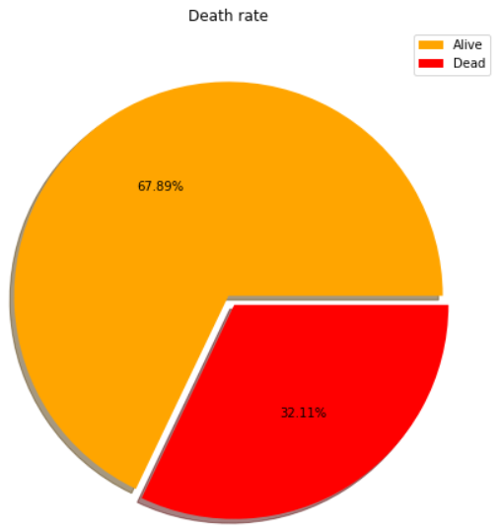

Slide 12
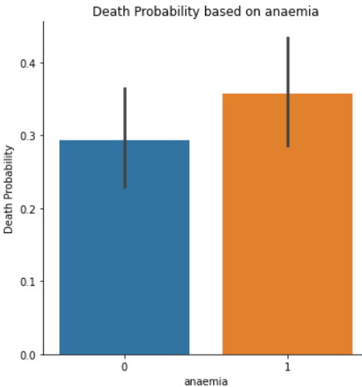
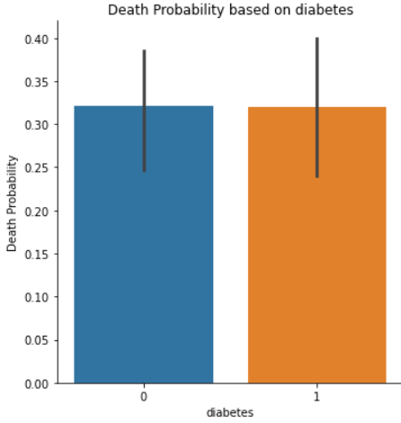


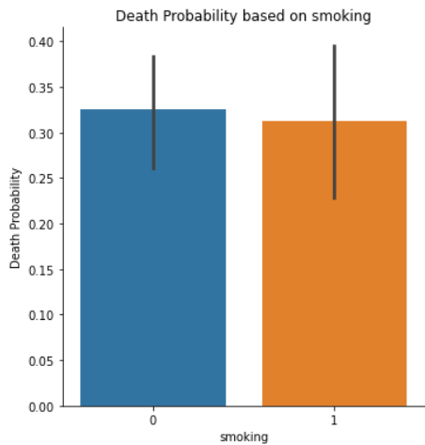

Slide 13
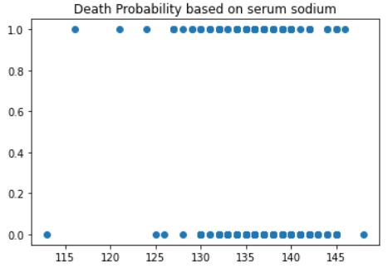
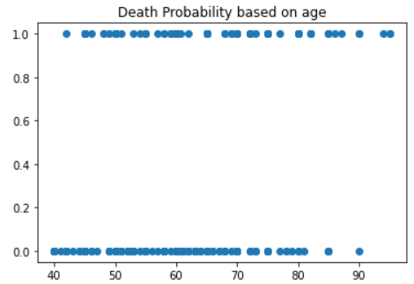
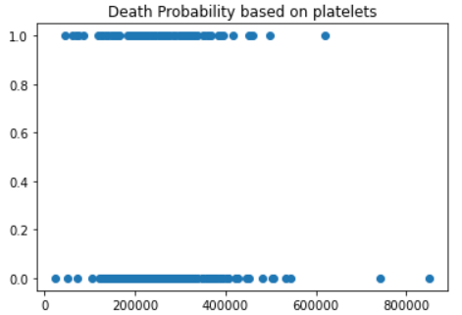
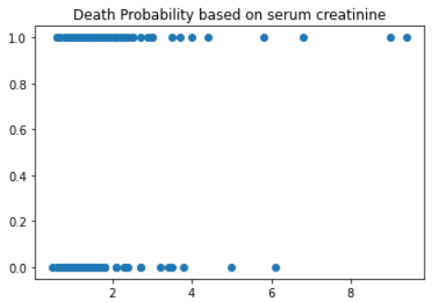
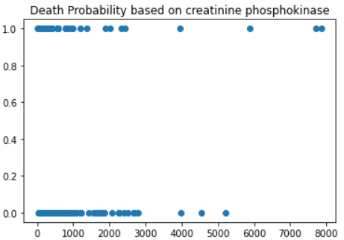
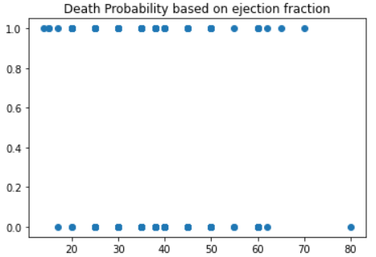

Slide 14
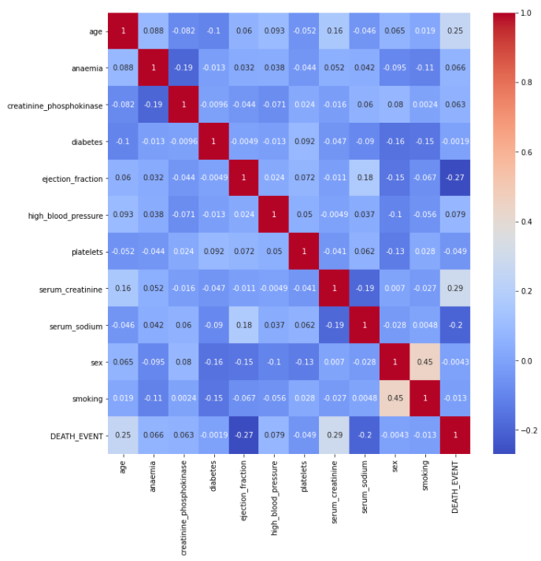
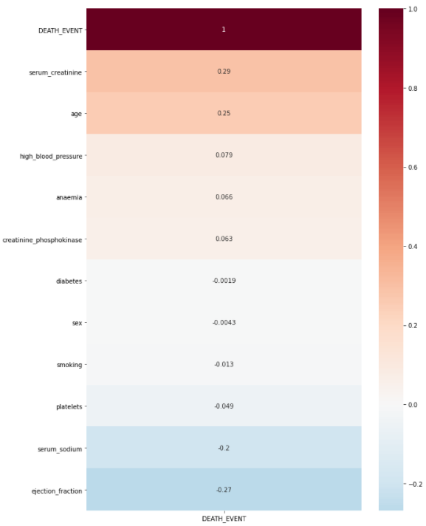

Slide 15
The visualization gives us an idea about the feature importances but we can not conclude at this stage

Slide 16
4. Model

Slide 17

Decision Tree Model
Decision Tree Model is a non-parametric supervised learning method used for classification and regression.
It is among the most popular machine learning algorithms given its intelligibility and simplicity.

Slide 18
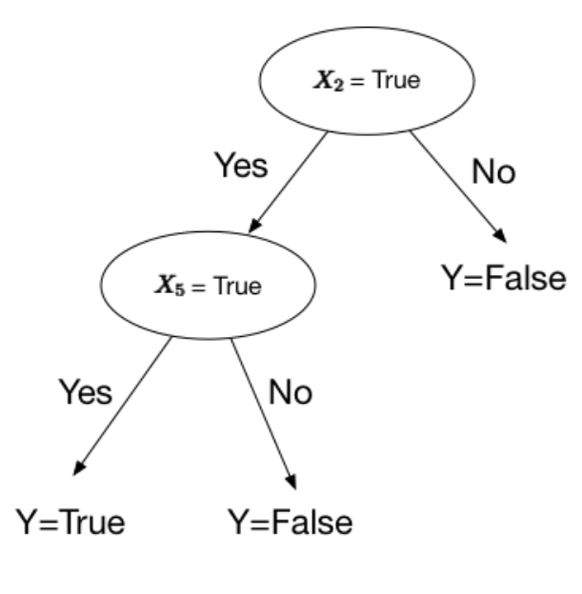
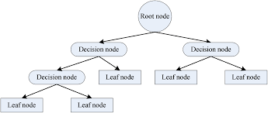
The goal is to create a model that predicts the death probability by learning simple decision rules inferred from the data features. A tree can be seen as a piecewise constant approximation.

Slide 19
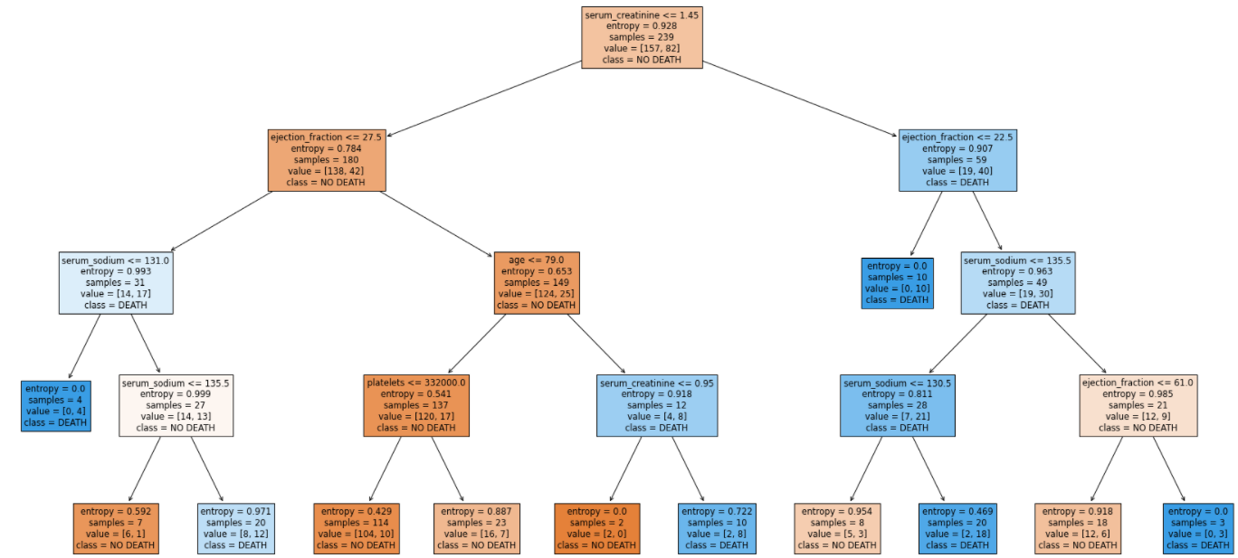

Slide 20
5. Results

Slide 21
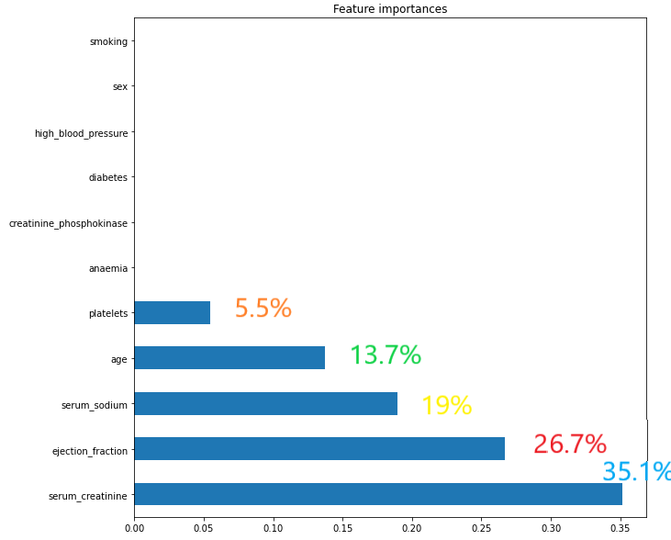

Slide 22
Train score
Test score
83.7%
81.7%

Slide 23
6. Conclusion

Slide 24
Thanks to the given dataset and our Decision Tree Model, we can now aproximatively predict a patient’s heart failure probability.

Slide 25
Thank you !

